Slide 1
COMP 5152 Advanced Data Analytics
Dr. Zhiyuan Wen
Lecture 9 Data Analysis based on Text Inputs 2

Slide 2
Agenda
Evaluating LMs
Attention
Transformer
Pre-trained Language Models
Large Language Models
Basic concepts of the NLP techniques in past 10 years
Logic behind the development of these techniques (why this route?)

Slide 3
Recap
Language Modeling
predicting what token comes the next given the preceding token sequence
N-gram language models
a probabilistic model to predict the likelihood of a token or a sequence given the preceding N-1 tokens
Basic Concept of RNN
processing (encoding/decoding) sequences of tokens by retaining memory of previous inputs tokens
Word, phrase, sub-word, Chinese character

Slide 4
Why should we care about Language Modeling?
Language modeling is a benchmark task that helps us measure our progress on understanding language
Language modeling is a sub-component of many NLP tasks:
Machine translation
Speeling/grammar correction
Summarization
Dialog systems
…
Language modeling is the meta task of pre-training large language models
Auto-regressive decoding
Language modeling != Language models
Understanding the input, generate the appropriate output accordingly
Notes:
Language modeling is a task, not the model itself. Language models are the actual models that are built and trained to perform tasks such as language modeling.

Slide 5
Evaluating Language Models
The standard evaluation metric for Language Models is perplexity
Perplexity of a sequence of T words generated by a LM:
The lower perplexity, the higher the probability of the tokens generated by the LM conform to the training data
The sequence generate by LM is more likely from the training data (our target of LM)
This is equal to the exponential of the cross-entropy loss $J(θ)$:
Lower perplexity is better
Notes:
This formula is saying that for every word xt, in the corpus, we compute the probability of that word given everything that came so far but its inverse is one over that, then we normaling this big product by the number of words which is capital T
The perplexity is gonna become bigger and bigger as your corpus got bigger if we don’t do the normalization
When you are training to minimize the loss, you are trying to optimize the perplexity as well. Lower perplexity is better
Perplexity is the inverse probability of corpus. Higher probability to the corpus, lower perplexity
The perplexity is the exponential of cross-entropy loss
That’s a good thing since we are training to minimize
Lowe perplexity is better

Slide 6
Training a RNN Language Model
Input data: a sequences of tokens $x^{(1)},…, x^{(T)}$
Training process: compute output distribution ${\hat{y}}^{(t)}$ for every step $t$
i.e., predict probability distribution of $x^{(t)}$, given tokens $x^{(1)},…, x^{(t−1)}$
Loss function on step $t$: the cross-entropy loss between predicted probability distribution ${\hat{y}}^{(t)}$, and the true next token ${\hat{y}}^{(t)}$
Average loss in all steps to get the overall loss for entire training data:
Training objective: minimizing the cross-entropy loss (minimizing the perplexity)
Notes:
Loss function on step t is cross-entrpy between predicted probability distrution y^ and the true next word y^
Average this to get overall loss for entire training set

Slide 7
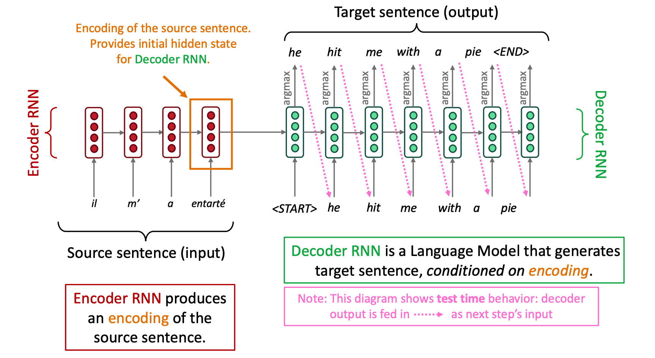
RNN for Machine Translation
Machine Translation (MT) is the task of translating a sentence x from one language (the source language) to a sentence y in another language (the target language)
MT is a conditional LM task
Sequence-to-sequence RNN model
Model training
Minimizing the cross-entropy loss among tokens in the predicted sentence by the model and tokens in ground truth target sentence
Information Bottleneck: Encoder RNN needs to capture all information about the source sentence
Is it really necessary in all scenarios?
For instance, a MT model does not need to be aware of the other words in the sentence when translating “boy” in the phrase “A boy is eating the banana.”
What if the sentence is too long? Gradient vanishing and exploding
Variants: Bidirectional RNN, GRU, LSTM
Attention
Source: https://web.stanford.edu/class/cs224n/slides/cs224n-2024-lecture06-fancy-rnn.pdf

Slide 8
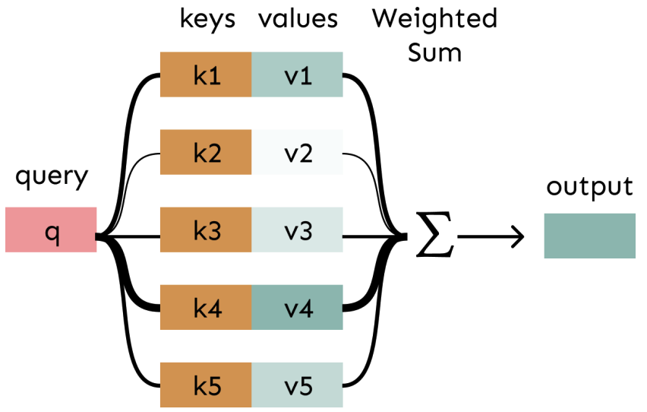
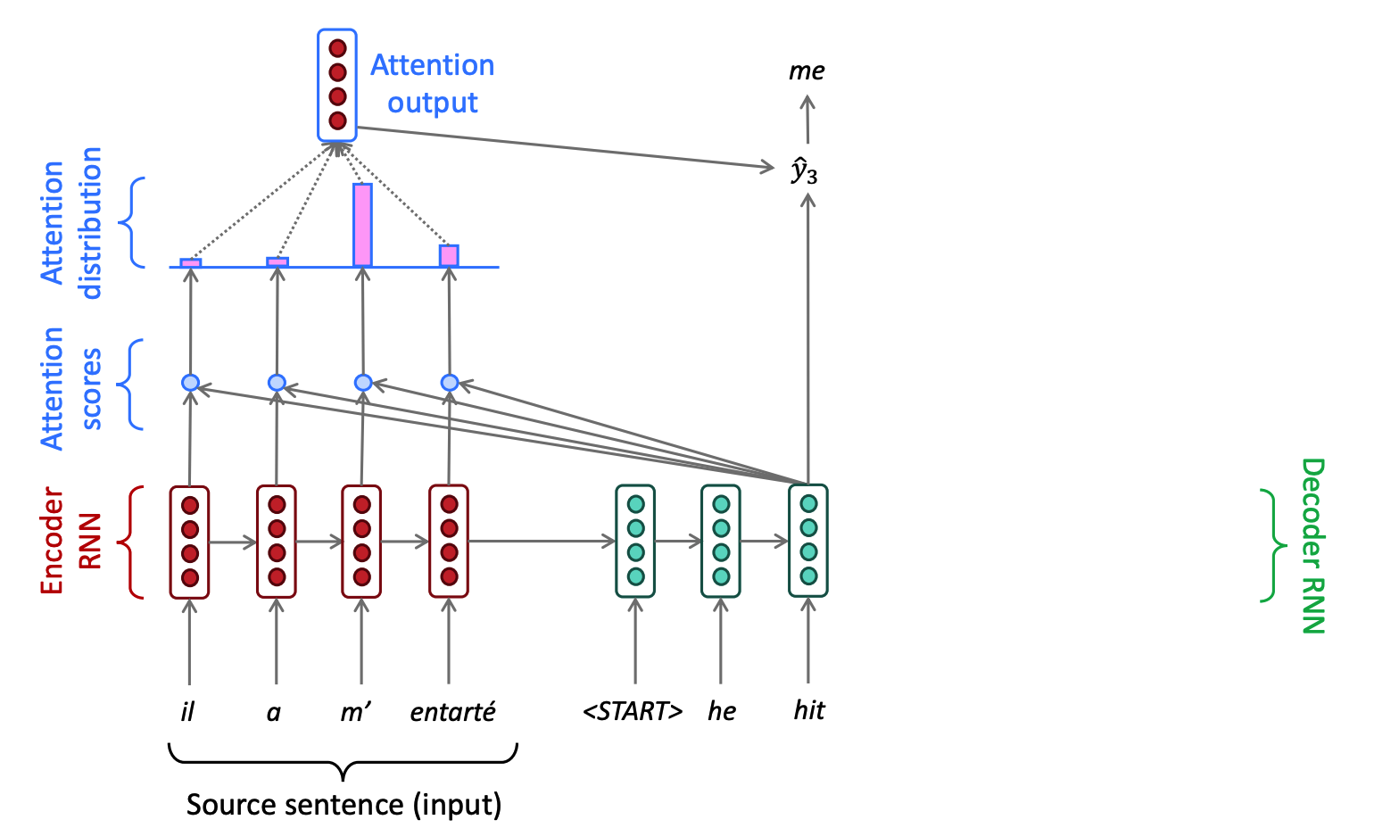
Attention-based RNN for Machine Translation
Attention is just a weighted average, weights (values) mean importance/correlation/similarity,…
On each step of the decoder, use direct connection to the encoder to focus on a particular part of the source sequence
output
values
keys
query
Source: https://web.stanford.edu/class/cs224n/slides/cs224n-2024-lecture06-fancy-rnn.pdf

Slide 9
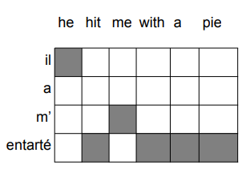
Attention
Attention provides more “human-like” model of the MT process
You can look back at the source sentence while translating, rather than needing to remember it all
Attention solves the bottleneck problem
Attention allows decoder the to look directly at source
Attention provides some interpretability
By inspecting attention distribution, we can see what the
decoder was focus on
Notes:
Transformer is self attention and FFNN

Slide 10
Language Modeling, RNN, and Attention
Language Modeling
predicting what token comes next given the preceding token sequence
RNN
processing sequences of tokens by retaining memory of previous inputs tokens
RNN-LM (language models based on RNN)
predicting tokens conditioned on the retaining memory
Attention-based RNN-LM
using weighted average of input, reminding RNN-LM and helping it focus on particular parts when RNN-LM forget
When input sequence is long, it’s difficult and unnecessary to remember all the information
Notes:
Transformer is self attention and FFNN

Slide 11
Attention is all you need^{[1]}?
Can we get rid of RNN?
If Attention can help to remind and focus, does it mean we no longer need RNN to remember?
If only using Attention, how we encode and how we generate(decode)?
Self-attention
Encoding (we know all the input tokens):
consider all input tokens for each step (potential to be parallel),
while RNN needs to wait
Decoding (we only know the generated tokens):
Generating t-th token, focusing on:
representations of the entire input from the encoder
the generated 1 to t-1 tokens by decoder
Illustration of self-attention for MT
[1] Vaswani A, Shazeer N, Parmar N, et al. Attention is all you need[J]. Advances in neural information processing systems, 2017, 30.
Notes:
Transformer is self attention and FFNN

Slide 12
Attention is all you need?
Compared with RNN, Are there any limitations by only using Attention?
Doesn’t have notions of order in sequences
RNN encodes sequentially
Attention encodes all tokens together
No nonlinearities for deep learning magic! It’s all just weighted averages
RNN has the non-linear activation functions
Attention only has linear calculation among scales, vectors and matrices
Need to ensure we don’t “look at the future” for variable-length sequence
RNN recurrently generates with one unit
Attention only has the fixed length structure for the entire input
Notes:
Transformer is self attention and FFNN

Slide 13
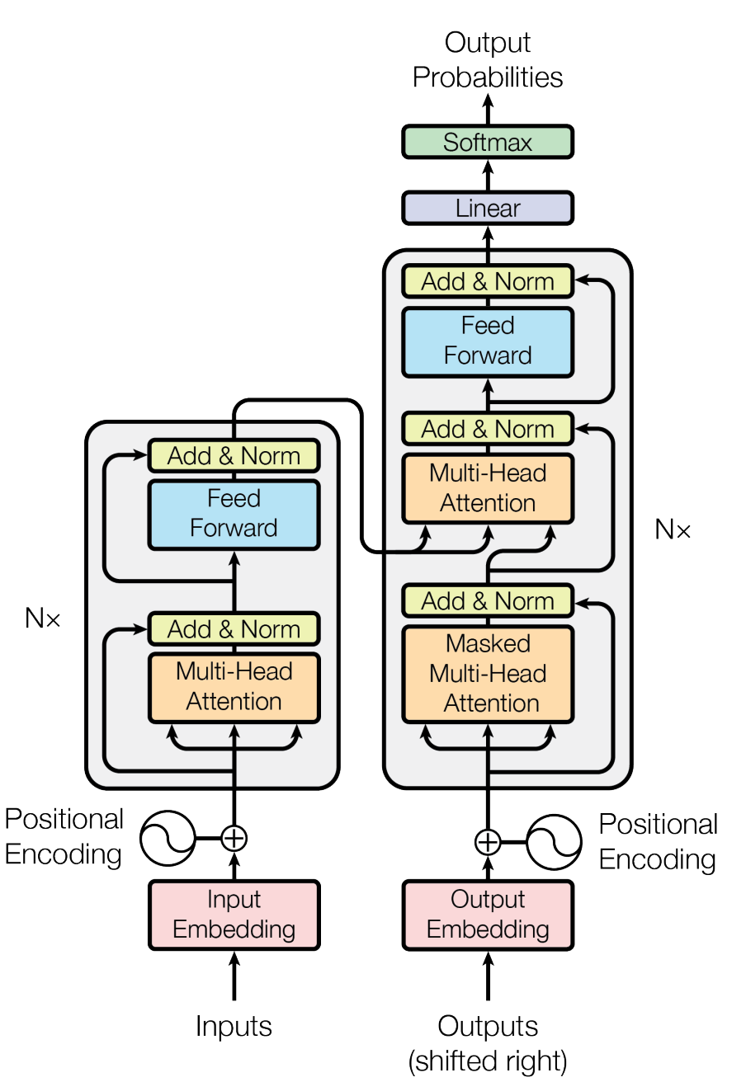
Transformer Model
Solve the limitations by only using Attention?
Doesn’t have notions of order in sequences
Positional encodings
No non-linearities for deep learning magic! It’s all just weighted averages
Applying the same feedforward network to each self-attention output
Need to ensure we don’t “look at the future”
Masking out the future by artificially setting attention weights to 0
(When generating t-th token, the input will also be the entire sequences, but besides the 1 to t-1 tokens, we manually set the attention weights for t to N (if the length of the entire sequence is N) tokens as 0, rather than calculation)
Wait, what is multi-head?
The transformer model
Notes:
Transformer is self attention and FFNN

Slide 14
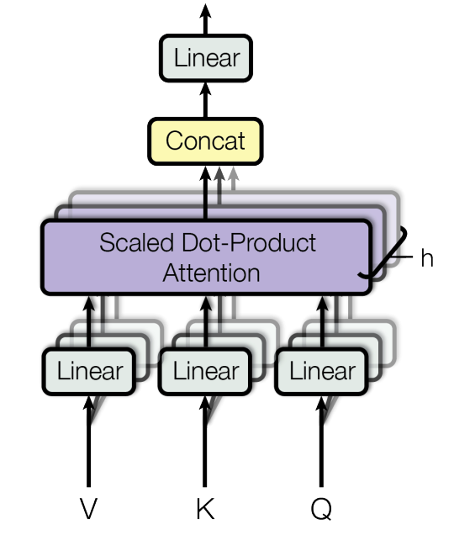
Multi-head Attention
What if we want to look in multiple parts in the sentence at once?
Translate the Chinese into English:
Multi-head attention captures the dependencies and relationships among different parts of the input sentence
Some empirical findings^{[1]} validated different head do extract different part of information for the same input sentence
皇马的主场是伯纳乌球场
head 1
head 2
Real Madrid's home stadium is the Santiago Bernabeu Stadium
(where I just visited last Friday, btw)
Multi-head attention
[1] Vig J. A multiscale visualization of attention in the transformer model[J]. arXiv preprint arXiv:1906.05714, 2019.
Notes:
Transformer is self attention and FFNN

Slide 15
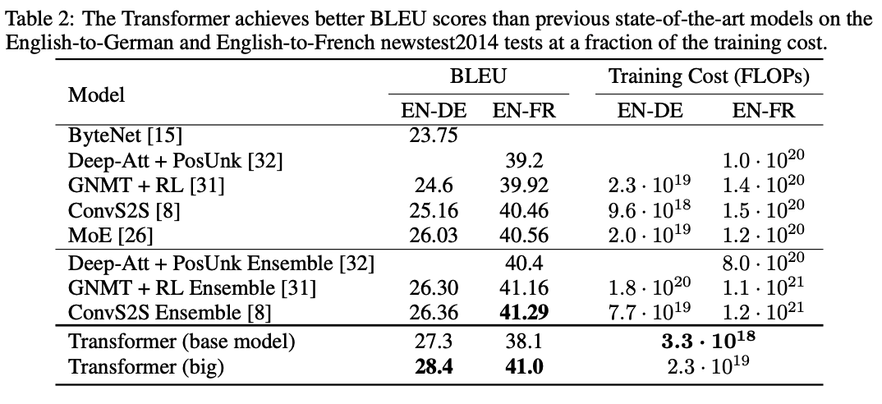
Performance of Transformer Model
Better translation results with lower training cost
Notes:
Transformer is self attention and FFNN

Slide 16
With Transformer, Pre-training is coming…
Back to 2018, what are the main issues in NLP we talked about…
Models are powerful for specific tasks, but different tasks require training different models
Text data is everywhere, but annotated data is very limited, manual labeling is labor-intensive
Can we train a large model which
can process large-scale datasets
is supervised by unlabeled data
can be easily adapted to different NLP tasks
Notes:
Transformer is self attention and FFNN

Slide 17
With Transformer, Pre-training is coming…
What pre-training task/data?
Some tasks doesn’t require annotated data (self-supervised), the data will be everywhere
Language Modeling?...
What model?
Transformers’ parallelizability allows processing multiple long sequences simultaneously
How to use?
Preserving parameters of the pre-trained large model and fine-tuning it with small amount of annotated data for specific tasks
Why it works?
Training NN models for specific tasks also requires the abilities pre-trained on general corpus
Notes:
Transformer is self attention and FFNN

Slide 18
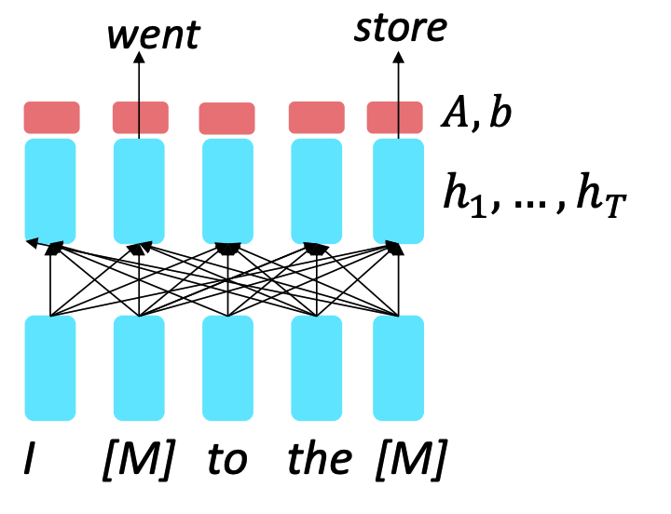
BERT: Bidirectional Encoder Representations from Transformers^{[1]}
Pre-training tasks
Masked Language Modeling (Encoder model)
replace some fraction of words in the input with a special [MASK] token; predict these words.
Self-supervised
bidirectional context
Next Sentence Prediction (less useful)
predict whether a pair of sentences in a given text are consecutive or not
Self-supervised
[1] Devlin J, Chang M W, Lee K, et al. Bert: Pre-training of deep bidirectional transformers for language understanding[J]. arXiv preprint arXiv:1810.04805, 2018.
Notes:
Transformer is self attention and FFNN

Slide 19
BERT: Bidirectional Encoder Representations from Transformers
Data
BooksCorpus (800 million words)
English Wikipedia (2,500 million words)
Model
BERT-base: 12 layers transformer, 768-dim hidden states, 12 attention heads, 110 million params
BERT-large: 24 layers transformer, 1024-dim hidden states, 16 attention heads, 340 million params
Computation Resource
pretrained with 64 TPU chips for a total of 4 days (TPUs are special tensor operation acceleration hardware)
Notes:
Transformer is self attention and FFNN

Slide 20
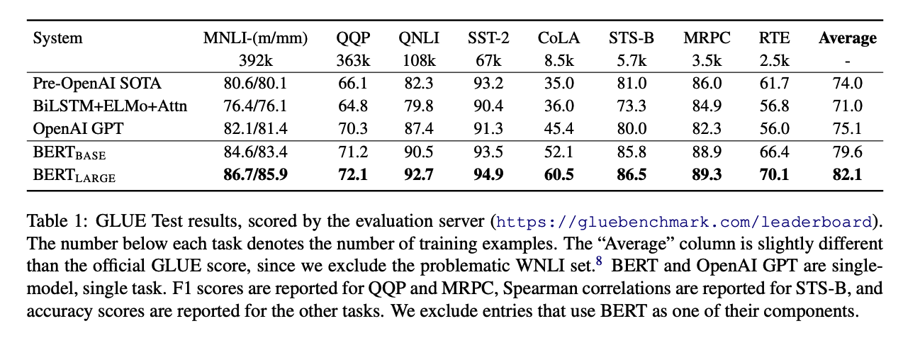
BERT: Bidirectional Encoder Representations from Transformers
Performance
finetuning BERT led to new state-of-the-art results on a broad range of tasks
but… these tasks are all about NLU (classification, sequence labeling…)
Remember the MT task? We used sequence-to-sequence model with RNN/Transformer
Decoder model
Pre-trained with LM
Notes:
Transformer is self attention and FFNN

Slide 21
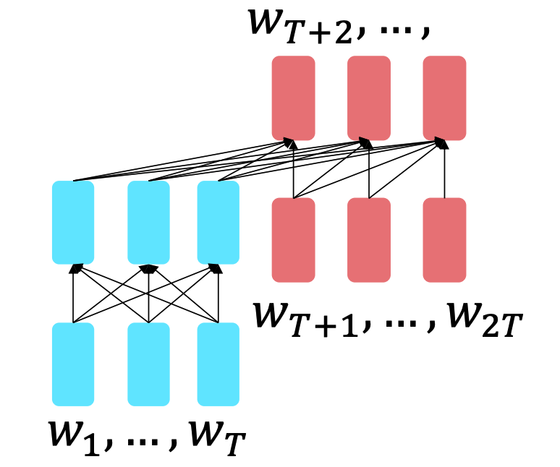
T5: Exploring the limits of transfer learning with a unified text-to-text transformer^{[1]}
Core idea:
Encoder benefits from bidirectional context
Decoder trained the whole model through language modeling
Pre-training task:
Span Corruption: Replace different-length spans from the input with unique placeholders; decode out the spans that were removed
[1] Raffel C, Shazeer N, Roberts A, et al. Exploring the limits of transfer learning with a unified text-to-text transformer[J]. Journal of machine learning research, 2020, 21(140): 1-67.
Notes:
Transformer is self attention and FFNN

Slide 22
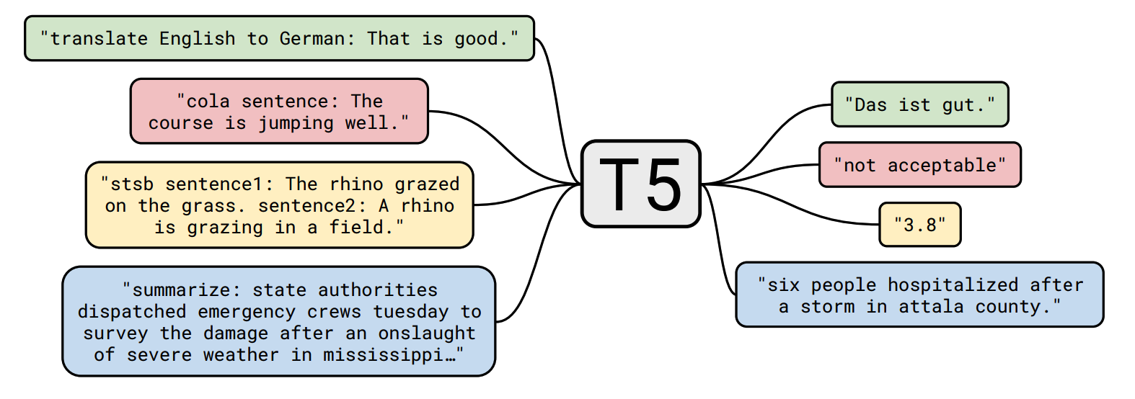
T5: Exploring the limits of transfer learning with a unified text-to-text transformer
T5 is easily to be fine-tuned for many tasks with instructive prefixes (both NLU and NLG tasks)
If you read the T5 paper, you will find it is a technical report of try-errors…
Research is not easily, and sometimes costly
Notes:
Transformer is self attention and FFNN

Slide 23
GPT:Improving Language Understanding by Generative Pre-Training^{[1]}
What if we only use Language Modeling for pre-training?
This idea occurs earlier than BERT
Only decoder is feasible for LM
Model
Transformer decoder with 12 layers, 117M parameters
768-dimensional hidden states, 3072-dimensional feed-forward hidden layers
Data
BooksCorpus: over 7000 unique books
Performance
Still focused on NLU tasks, achieved State-of-the-art on Natural Language Inference tasks after fine-tuning
[1] Radford A, Narasimhan K, Salimans T, et al. Improving language understanding by generative pre-training[J]. 2018.
Notes:
Transformer is self attention and FFNN

Slide 24
GPT-2: Language Models are Unsupervised Multitask Learners^{[1]}
Language Modeling:
predicting what token comes next given the preceding token sequence
generating text with given the preceding context
GPT-2: similar architecture, larger version, trained on more data
produce relatively convincing samples of natural language (with low perplexity)
Continue story
Writing emails
…
but… it looked like only generates what have seen in the training data
Although long and fluent
Not always logically correct
Not always as our wishes
[1] Radford A, Wu J, Child R, et al. Language models are unsupervised multitask learners[J]. OpenAI blog, 2019, 1(8): 9.
Notes:
Transformer is self attention and FFNN

Slide 25
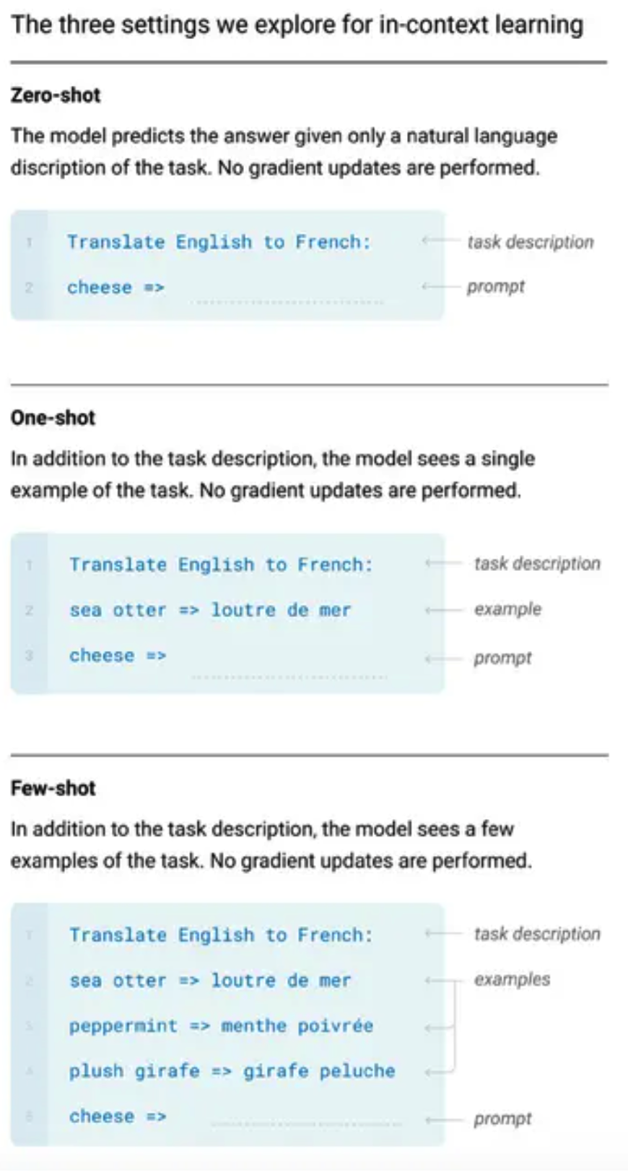
GPT-3: Language models are few-shot learners^{[1]}
Still pre-training on Language Modeling (see how important LM is…)
Model size became huge…
The largest T5 model had 11 billion parameters
GPT-3 has 175 billion parameters
Some magic happened: in-context learning
When apply GPT-3 on some specific tasks, you no longer need fine-tuning (you are also probably no longer able to…)
You just describe your task, shown one/several examples if you like, model can conduct your tasks, without changing any model parameters
OpenAI → CloseAI, GPT-3 and models afterwards are no longer open-sourced
[1] Brown T, Mann B, Ryder N, et al. Language models are few-shot learners[J]. Advances in neural information processing systems, 2020, 33: 1877-1901.
Notes:
Transformer is self attention and FFNN

Slide 26
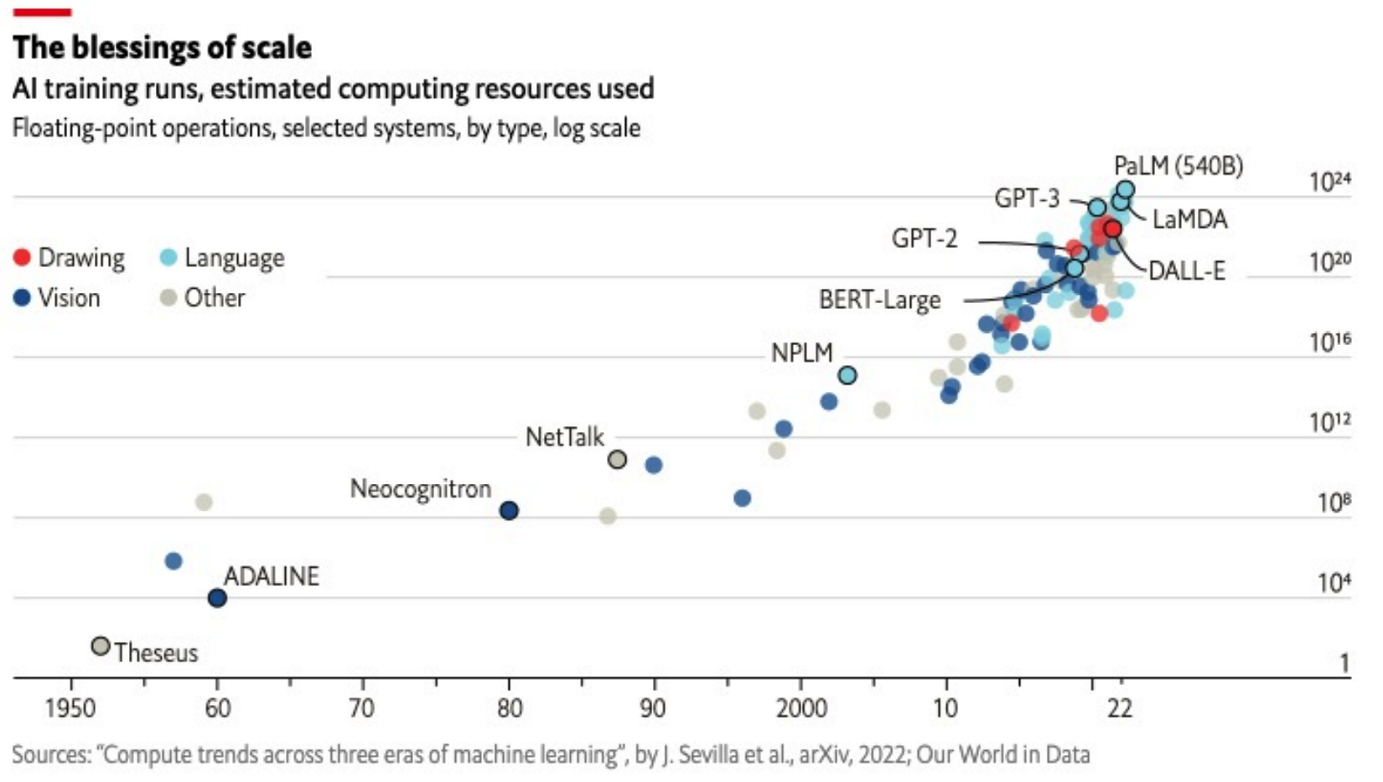
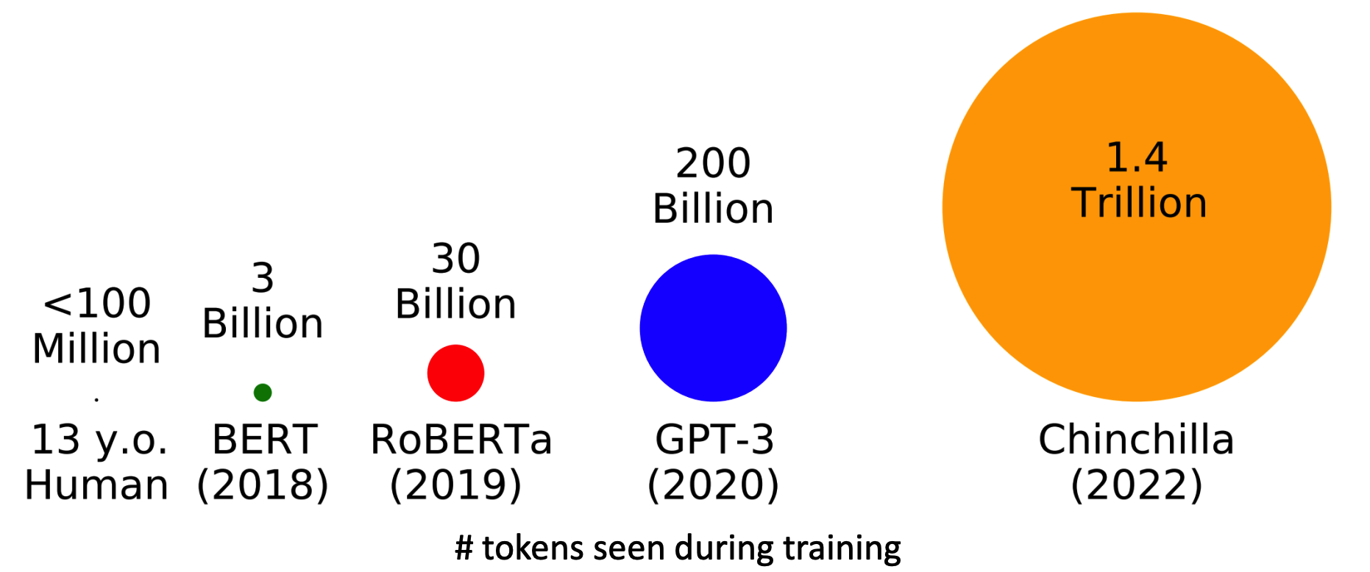
Models are larger, training data is more
Notes:
Transformer is self attention and FFNN

Slide 27
Models are larger, training data is more
With so much resource cost, how can we apply pre-trained large language models to really help us, by listening to us, following our instruction, giving us what we want…
Some said:
Model become larger, it’s impractical to fine-tuning models for specific tasks, no computation resource
GPT-3 has learnt everything, we just learn to induce its knowledge contains for our need
Others said:
We still need to teach model teach to learn to follow our instructions
Prompting V.S. Instructive Fine-tuning
Notes:
Transformer is self attention and FFNN

Slide 28
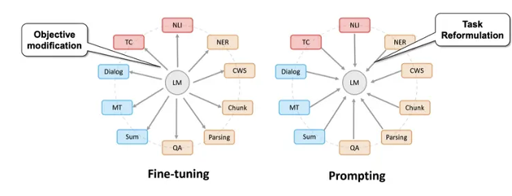
Prompting (Prompt Engineering)
Unify downstream tasks into pre-training tasks by using specific manual-designed prompting templates
Fix model parameters, search for prompts with best performance
https://link.zhihu.com/?target=https%3A//www.bilibili.com/video/BV1Sf4y1g7ra%3Ffrom%3Dsearch%26seid%3D12417442891380693418%26spm_id_from%3D333.337.0.0
Notes:
Transformer is self attention and FFNN

Slide 29
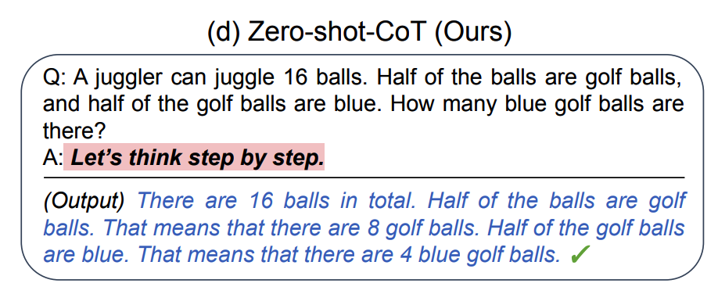
Chain-of-thought (CoT) Prompting
Investigating the reasoning ability of LLMs
[1] Kojima T, Gu S S, Reid M, et al. Large language models are zero-shot reasoners[J]. Advances in neural information processing systems, 2022, 35: 22199-22213
[2] Wei J, Wang X, Schuurmans D, et al. Chain-of-thought prompting elicits reasoning in large language models[J]. Advances in neural information processing systems, 2022, 35: 24824-24837.
Notes:
Transformer is self attention and FFNN

Slide 30
Prompting (Prompt Engineering)
Pros
Parameter efficient (almost no need for adjusting model parameters)
Efficiently using pre-trained knowledge
Cons
Design prompting is an art (different prompts generate various results for the same task)
More like an engineering rather than research
What if LLMs did not learn everything?
Notes:
Transformer is self attention and FFNN

Slide 31
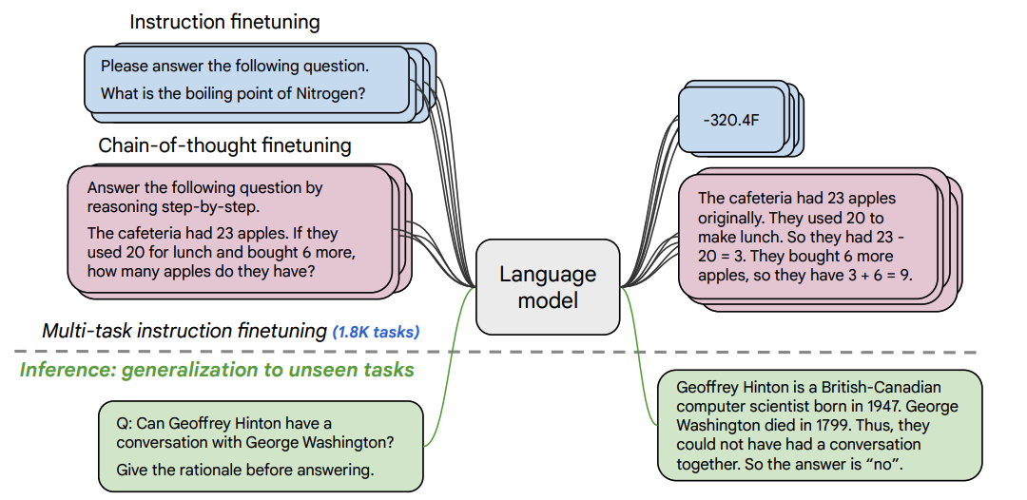
Instructive Fine-tuning Large Language Models
Fine-tuning LLMs to learn to follow our instructions, even for unseen tasks^{[1]}
T5 models finetuned on 1.8K additional tasks
Pros
Model can indeed learn to following instructions
Simple and straightforward
Cons
Collecting demonstrations for so many tasks is expensive
Mismatch between LM objective and human preferences
tasks like open-ended creative generation have no right answer
Language Modeling penalizes all token-level mistakes equally, but some errors are worse than others
[1] Chung H W, Hou L, Longpre S, et al. Scaling instruction-finetuned language models[J]. arXiv preprint arXiv:2210.11416, 2022.
Notes:
Transformer is self attention and FFNN

Slide 32
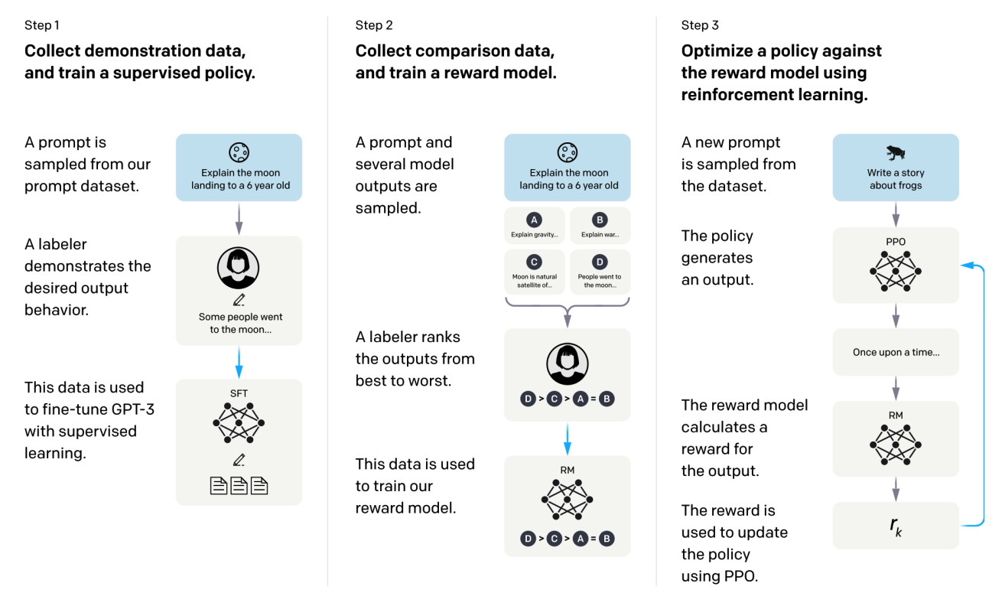
Reinforcement Learning from Human Feedbacks (RLHF)
Instructive Supervised Fine-tune (SFT) on GPT-3 based on some collected SFT datasets
Collect manually labeled comparison data and train the reward model (Reword Model, RM)
Use RM as the optimization target of reinforcement learning and use the PPO algorithm to fine-tune the SFT model
InstructGPT^{[1]}
[1] Ouyang L, Wu J, Jiang X, et al. Training language models to follow instructions with human feedback[J]. Advances in neural information processing systems, 2022, 35: 27730-27744.
Notes:
Transformer is self attention and FFNN

Slide 33
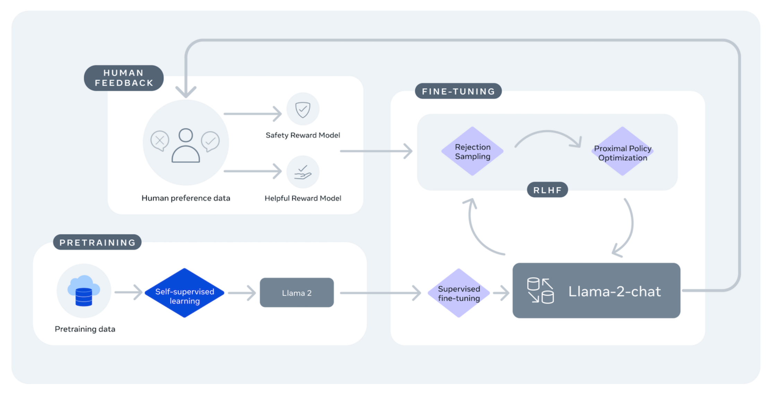
Instructive SFT + RLHF
Standard workflow for training LLMs
ChatGPT: InstructGPT focus on the conversational scenarios (probably)
Llama-2-chat:
Llama 2 + Instructive SFT + RLHF
Llama 2 is pretrained using publicly available online data
…
Notes:
Transformer is self attention and FFNN

Slide 34
NLP Research Trends in era of LLMs
Training domain-specific LLMs (Powerful NLU and NLG ability)
finance, legal, medical, scientific documents,…
Emotional intelligence (Powerful conversational ability)
emotional support, elderly companion, mental health therapy, …
Parameter-efficiency
model quantization, parameter-efficient fine-tuning (LoRA), P-tuning, …
Enhancing specific skills
retrieval augmented generation, adaptation, knowledge enhancement, …
Trends are led by large companies and famous research groups…
Notes:
Transformer is self attention and FFNN

Slide 35
Development of NLP techniques
If you learn NLP before 2010…
rule-based methods with linguistics knowledge
statistical features, maybe traditional ML models (SVM, DT,…)
If you learn NLP before 2018…
word vectors + RNN, CNN, GRU, LSTM, …
attention-based NNs, bidirectional NNs, Multi-layer NNs, …
If you learn NLP before 2022…
fine-tuning Pre-trained Models like BERT, RoBERTa, T5, GPT-2
If you learn NLP before 2024…
prompting, SFT, investigating different abilities of SOTA LLMs
If you learn NLP now…
Do you still want to learn NLP?
Model sizes are bigger and bigger, technical issues seem less and less…
The things we can do in NLP is less?
Multi-modality?
Reasoning ability?
Factual correctness?
Ethical concerns and governance?
…
History tells us: technics kill old jobs, but create better expectations, so as the new requirements and new jobs…
Notes:
Transformer is self attention and FFNN

Slide 36
Research Assistant Wanted
If the answer for you is YES!
If you interested in conversational AI, personality/emotion in dialog systems,…
Can chatbot recognize the personality of users and provide personalized responses?
How do we specify personality to chatbot and let it generate emotional responses according to its personality?
Does LLM have its own personality? How do we induce it and how do we control it as our wishes?
My personal website and my defense slide
Send application with cv to zyuanwen@polyu.edu.hk

Slide 37
References & Recommended materials
Some materials are based on Stanford CS224n
Speech and Language Processing from Dr. Dan Jurafsky
Open Lectures from Dr. Hung-yi Lee (in Chinese)
CoLab, Huggingface, …
This slide does not include all the mainstream NLP models, definitely does not contain all the technical details
This is just introduction and organization. To master the skills, the knowledge is still there

